Slide 1

CHAPTER 6
SET THEORY
Copyright © Cengage Learning. All rights reserved.

Slide 2
SECTION 6.3
Disproofs, Algebraic Proofs, and Boolean Algebras
Copyright © Cengage Learning. All rights reserved.

Slide 3
Disproving an Alleged Set Property

Slide 4
Disproving an Alleged Set Property
We have known that to show a universal statement is false, it suffices to find one example (called a counterexample) for which it is false.

Slide 5
Example 1 – Finding a Counterexample for a Set Identity
Is the following set property true?
For all sets A, B, and C,
Solution:
Observe that the property is true if, and only if,
the given equality holds for all sets A, B, and C.
So it is false if, and only if,
there are sets A, B, and C for which the equality does
not hold.

Slide 6
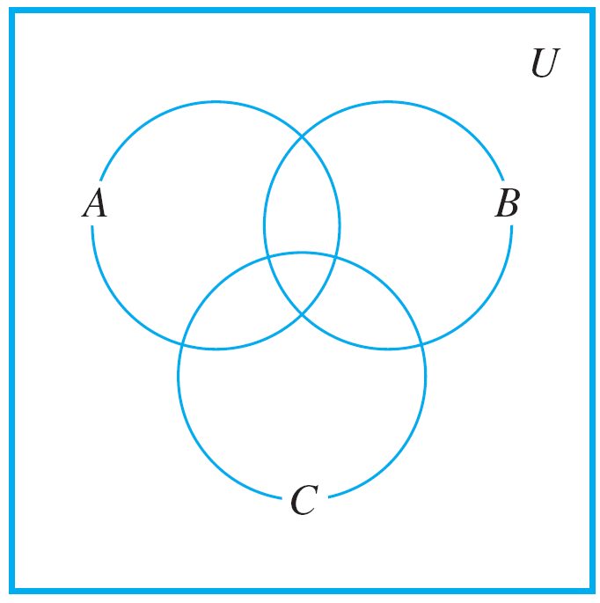
Example 1 – Solution
cont’d
One way to solve this problem is to picture sets A, B, and C by drawing a Venn diagram such as that shown in
Figure 6.3.1.
Figure 6.3.1

Slide 7
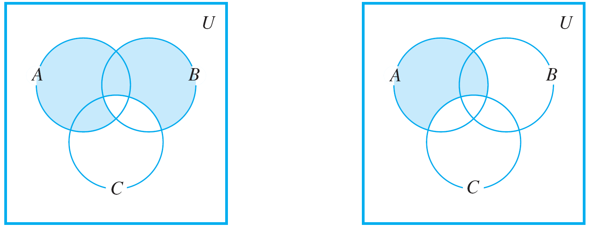
Example 1 – Solution
cont’d
If you assume that any of the eight regions of the diagram may be empty of points, then the diagram is quite general.
Find and shade the region corresponding to
(A – B) ∪ (B – C). Then shade the region corresponding to A – C. These are shown in Figure 6.3.2.
Figure 6.3.2

Slide 8
Example 1 – Solution
cont’d
Comparing the shaded regions seems to indicate that the property is false.
For instance, if there is an element in B that is not in either A or C then this element would be in (A – B) ∪ (B – C) (because of being in B and not C) but it would not be in
A – C since A – C contains nothing outside A.
Similarly, an element that is in both A and C but not B would be in (A – B) ∪ (B – C) (because of being in A and not B), but it would not be in A – C (because of being in both A and C).

Slide 9
Example 1 – Solution
cont’d
Construct a concrete counterexample in order to confirm your answer and make sure that you did not make a mistake either in drawing or analyzing your diagrams.
One way is to put one of the integers from 1–7 into each of the seven subregions enclosed by the circles representing A, B, and C.
If the proposed set property had involved set complements, it would also be helpful to label the region outside the circles, and so we place the number 8 there.

Slide 10
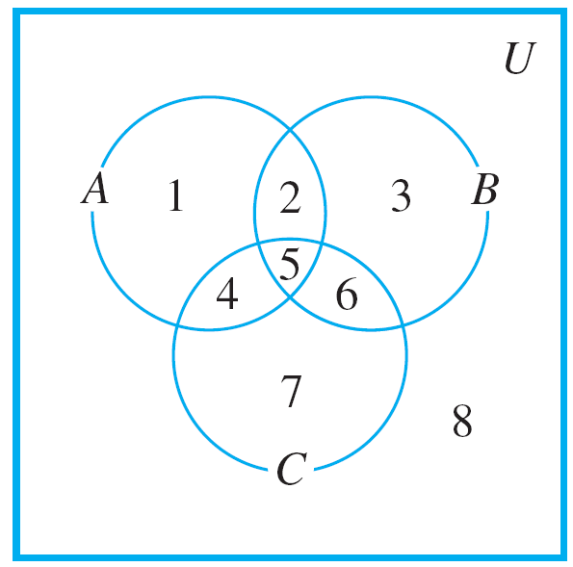
Example 1 – Solution
cont’d
(See Figure 6.3.3.) Then define discrete sets A, B, and C to consist of all the numbers in their respective subregions.
Figure 6.3.3

Slide 11
Example 1 – Solution
cont’d
Counterexample 1:
Then
Hence

Slide 12
Problem-Solving Strategy

Slide 13
Problem-Solving Strategy
How can you discover whether a given universal statement about sets is true or false? There are two basic approaches: the optimistic and the pessimistic.
In the optimistic approach, you simply plunge in and start trying to prove the statement, asking yourself, “What do I need to show?” and “How do I show it?”
In the pessimistic approach, you start by searching your mind for a set of conditions that must be fulfilled to construct a counterexample.
With either approach you may have clear sailing and be immediately successful or you may run into difficulty.

Slide 14
The Number of Subsets of a Set

Slide 15
The Number of Subsets of a Set
The following theorem states the important fact that if a set has n elements, then its power set has 2^{n} elements.
The proof uses mathematical induction and is based on the following observations. Suppose X is a set and z is an element of X.
1. The subsets of X can be split into two groups: those that
do not contain z and those that do contain z.
2. The subsets of X that do not contain z are the same as
the subsets of X – {z}.

Slide 16
The Number of Subsets of a Set
3. The subsets of X that do not contain z can be matched up one for one with the subsets of X that do contain z by matching each subset A that does not contain z to the subset A ∪ {z} that contains z.
Thus there are as many subsets of X that contain z as there are subsets of X that do not contain z.

Slide 17
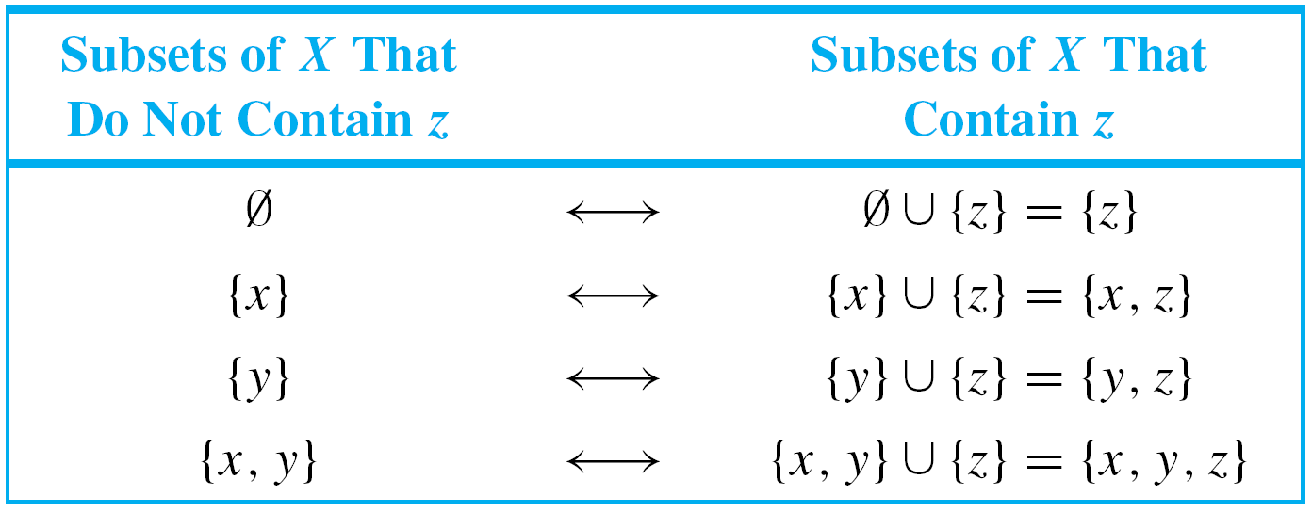
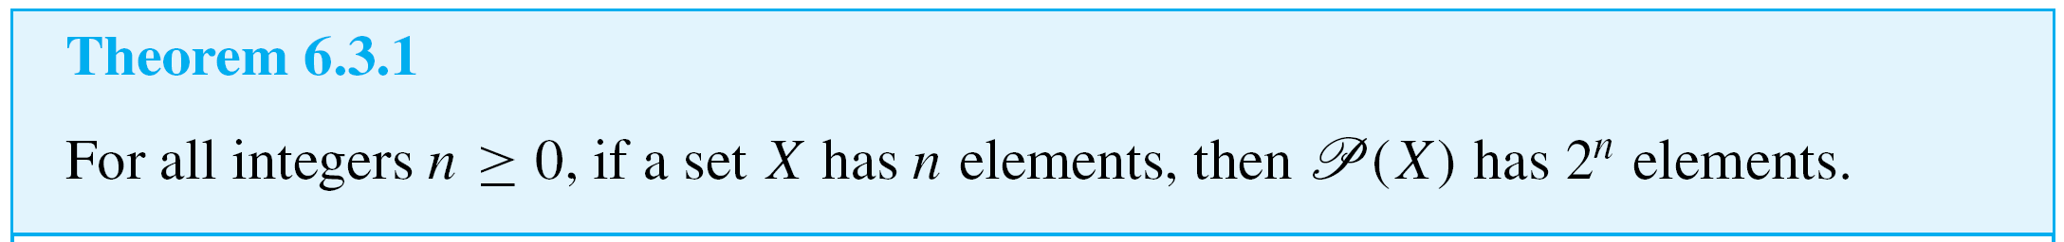
The Number of Subsets of a Set
For instance, if X = {x, y, z}, the following table shows the correspondence between subsets of X that do not contain z and subsets of X that contain z.

Slide 18
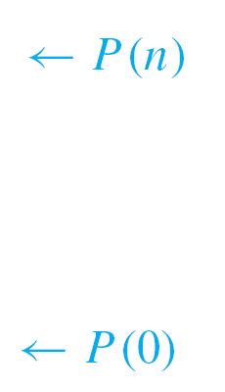
The Number of Subsets of a Set
Proof (by mathematical induction):
Let the property P(n) be the sentence
Any set with n elements has 2^{n} subsets.
Show that P(0) is true:
To establish P(0), we must show that
Any set with 0 elements has 2⁰ subsets.
But the only set with zero elements is the empty set, and the only subset of the empty set is itself.
Thus a set with zero elements has one subset. Since
1 = 2⁰, we have that P(0) is true.

Slide 19
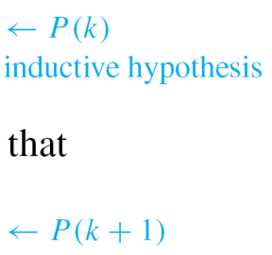
The Number of Subsets of a Set
Show that for all integers k ≥ 0, if P(k) is true then
P(k + 1) is also true: [Suppose that P(k) is true for a particular but arbitrarily chosen integer k ≥ 0. That is:]
Suppose that k is any integer with k ≥ 0 such that
Any set with k elements has 2^{k} subsets.
[We must show that P(k + 1) is true. That is:]
We must show that
Any set with k + 1 elements has 2^{k+1} subsets.

Slide 20
The Number of Subsets of a Set
Let X be a set with k + 1 elements. Since k + 1 ≥ 1, we may pick an element z in X. Observe that any subset of X either contains z or not.
Furthermore, any subset of X that does not contain z is a subset of X – {z}. And any subset A of X – {z} can be matched up with a subset B, equal to A ∪ {z}, of X that contains z.
Consequently, there are as many subsets of X that contain z as do not, and thus there are twice as many subsets of X as there are subsets of X – {z}.

Slide 21
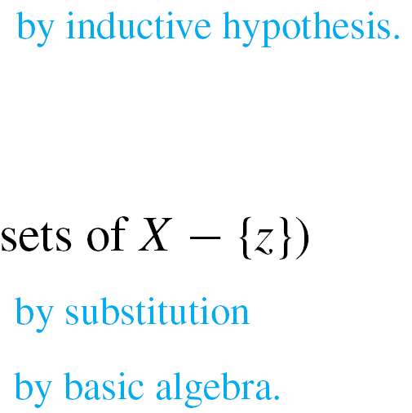


The Number of Subsets of a Set
But X – {z} has k elements, and so
Therefore,
[This is what was to be shown.]
[Since we have proved both the basis step and the inductive step, we conclude that the theorem is true.]

Slide 22
“Algebraic” Proofs of Set Identities

Slide 23

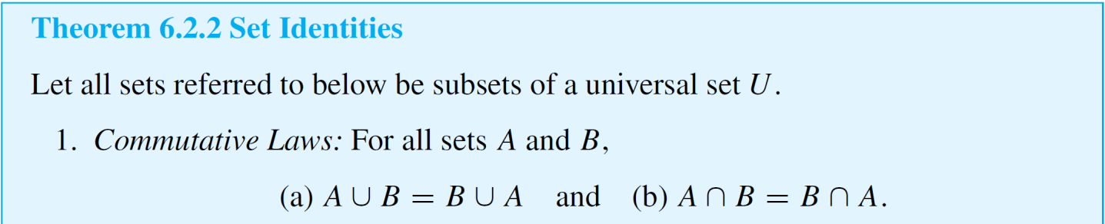
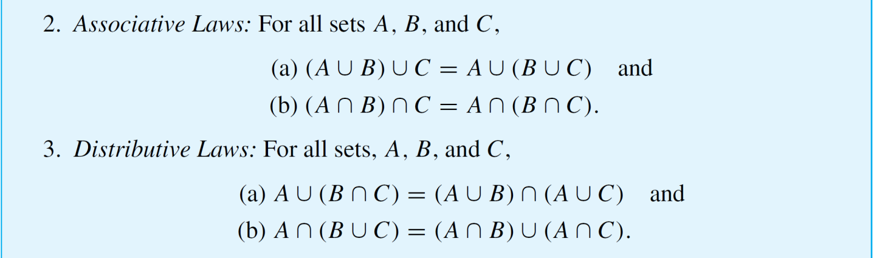
“Algebraic” Proofs of Set Identities
Let U be a universal set and consider the power set of U,
. The set identities given in Theorem 6.2.2 hold for all elements of .

Slide 24
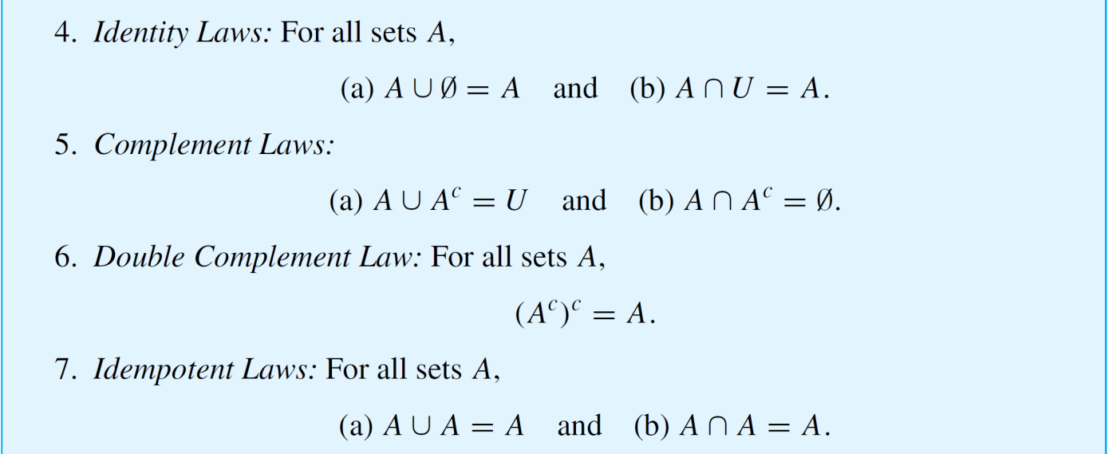
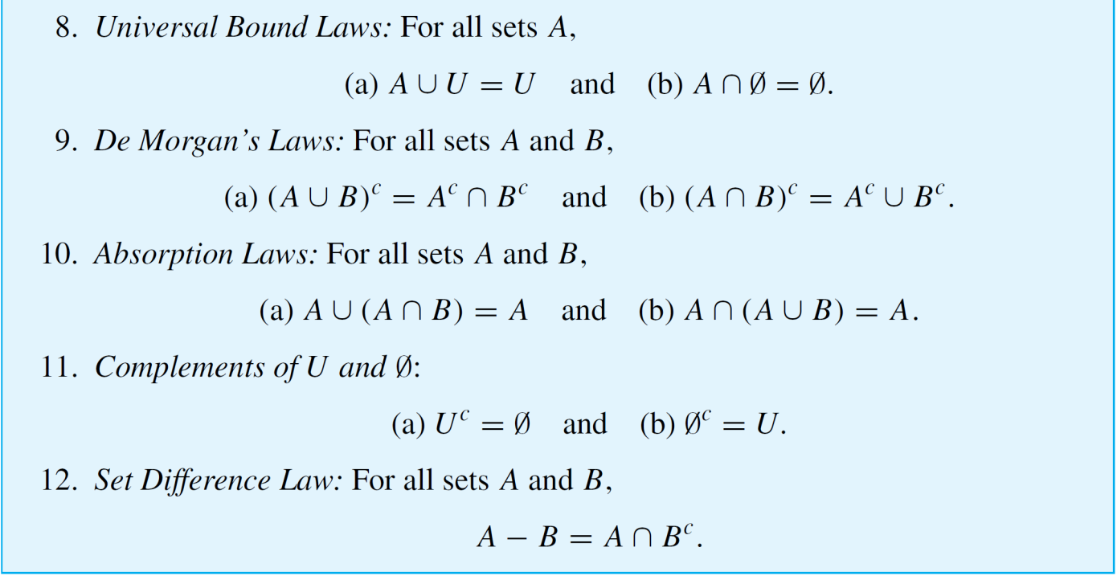
“Algebraic” Proofs of Set Identities
cont’d

Slide 25
“Algebraic” Proofs of Set Identities
Once a certain number of identities and other properties
have been established, new properties can be derived from
them algebraically without having to use element method
arguments.
It turns out that only identities (1–5) of Theorem 6.2.2 are needed to prove any other identity involving only unions, intersections, and complements.

Slide 26
“Algebraic” Proofs of Set Identities
With the addition of identity (12), the set difference law, any set identity involving unions, intersections, complements, and set differences can be established.
To use known properties to derive new ones, you need to use the fact that such properties are universal statements. Like the laws of algebra for real numbers, they apply to a wide variety of different situations.
Assume that all sets are subsets of , then, for instance, one of the distributive laws states that
for all sets A, B, and C,

Slide 27

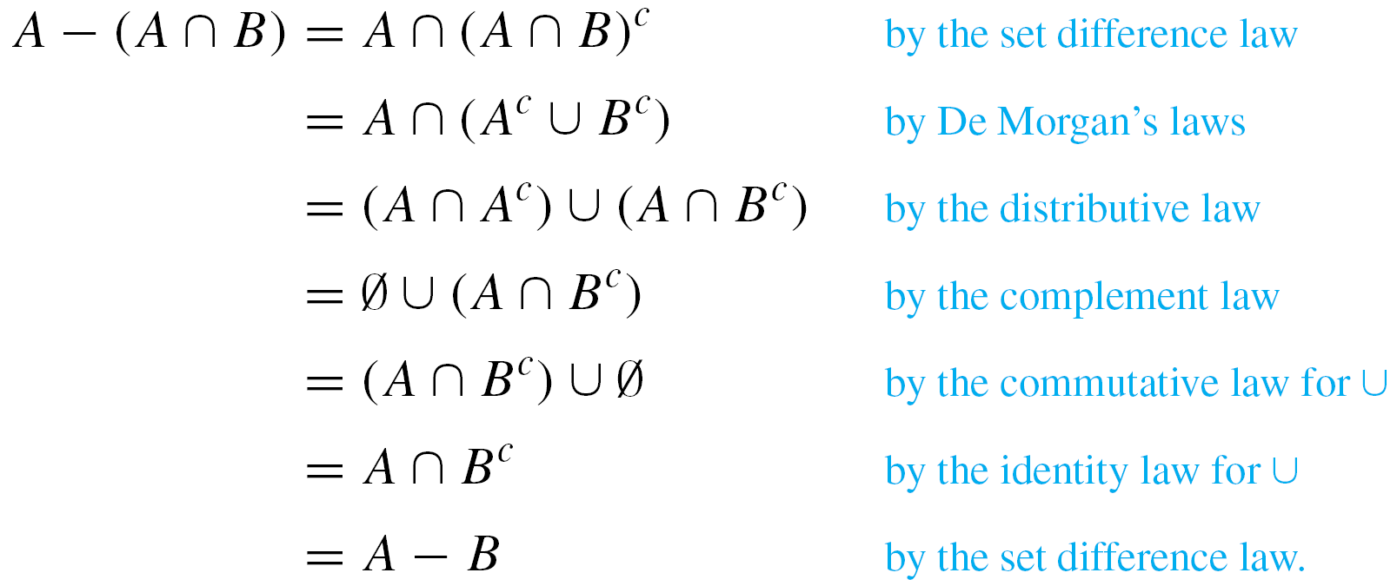
Example 3 – Deriving a Set Identity Using Properties of Ø
Construct an algebraic proof that for all sets A and B,
Cite a property from Theorem 6.2.2 for every step of the proof.
Solution:
Suppose A and B are any sets. Then

Slide 28
Example 3 – Solution
cont’d

